Slide 1
Google Stock Price Prediction using LSTM
Presented By: Hari Prakash M
Register No: 711721243306
Department: Artificial Intelligence and Data Science
3/21/2024 Annual Review

Slide 2
PROJECT TITLE
Google Stock Price Prediction using LSTM
3/21/2024 Annual Review

Slide 3


AGENDA
Problem Statement
Project overview
Who are the end users?
Our Solution and Value Proposition
The Wow in your solution
Modelling approach
Results and Evaluation
Conclusion
3/21/2024 Annual Review

Slide 4

PROBLEM STATEMENT
Design and implement a Long Short-Term Memory (LSTM) neural network model to predict the future stock prices of Google (GOOGLE).
Utilize historical stock price data along with relevant features such as trading volume, opening price, closing price, and other relevant financial indicators to train the model.
The goal is to create a robust predictive model that can accurately forecast the future price movements of Google stock over a specified time horizon.

Slide 5

PROJECT OVERVIEW
The aim is to gather historical stock price data of Google (GOOGLE) and relevant financial indicators. Preprocess the data by cleaning, selecting features, and splitting into training, validation, and testing sets.
To design the LSTM neural network architecture for stock price prediction, including input layer configuration, hidden layers, and output layer. Train the model using historical data, optimize hyperparameters, and employ techniques like regularization and early stopping to enhance performance.
To evaluate the trained LSTM model using metrics like MSE, RMSE, MAE, and R-squared score. Compare predicted prices with actual prices and visualize performance.

Slide 6

WHO ARE THE END USERS?
Investors and Traders
Financial Analysts
Algorithmic Trading Platforms
Financial Software Developers
Academic Researchers
3/21/2024 Annual Review

Slide 7

YOUR SOLUTION AND ITS VALUE PROPOSITION
SOLUTION:
Utilizing Long Short-Term Memory (LSTM) neural networks for stock price prediction, our solution integrates cutting-edge machine learning techniques with robust financial analysis to forecast Google (GOOGL) stock prices accurately.
VALUE PROPOSITION:
Our solution for stock price prediction using LSTM neural networks offers unparalleled accuracy, timely insights, enhanced risk management, and decision support, along with scalability, adaptability, continuous improvement, and ethical considerations, providing tangible value to investors, analysts, and financial institutions navigating dynamic financial markets.

Slide 8

THE WOW IN YOUR SOLUTION
Exceptional Accuracy: Achieves superior accuracy in forecasting Google (GOOGLE) stock prices, surpassing traditional methods and providing reliable insights to investors.
Real-Time Integration and Adaptability: Seamlessly integrates with real-time data feeds, adapts to changing market conditions, and delivers timely insights, enabling users to make informed decisions in dynamic environments.
Actionable Insights and Usability: Empowers users with actionable insights through a user-friendly interface, facilitating informed decision-making and strategic planning, while upholding ethical standards.
3/21/2024 Annual Review
‹#›

Slide 9
MODELLING
1.) Model Architecture:
LSTM neural network architecture chosen for its ability to capture long-term dependencies in time-series data.
Sequential layers including LSTM layers with appropriate activation functions (e.g., tanh) and output layer for predicting future stock prices.
2.) Data Preprocessing:
Robust cleaning process to handle missing values, outliers, and inconsistencies in the historical stock price data.
Comprehensive feature selection and extraction to identify relevant predictors such as trading volume, opening price, and previous day's closing price.
3.) Training Process:
Utilization of training dataset to iteratively update model parameters through backpropagation and gradient descent.
Adoption of appropriate loss functions (e.g., Mean Squared Error) to quantify prediction errors and optimization algorithms (e.g., Adam optimizer) for efficient parameter updates.
‹#›

Slide 10
MODELLING
4.) Evaluation:
Calculation of key evaluation metrics including Mean Squared Error (MSE), Root Mean Squared Error (RMSE), Mean Absolute Error (MAE), and R-squared (R2) score to assess model performance.
Visualization of model predictions against actual stock prices through plots and charts to evaluate accuracy and reliability.
5.) Fine Tuning and Optimization:
Systematic hyperparameter tuning to optimize model performance, including experimentation with batch sizes, learning rates, and architectural configurations.
Exploration of advanced techniques such as ensemble methods or transfer learning to further enhance prediction capabilities.
6.) Deployment:
Packaging of trained model along with necessary dependencies and configurations for deployment in a production environment.
Development of APIs or integration points for seamless integration with existing systems or applications.
Implementation of robust monitoring and logging mechanisms to track model performance and usage in real-time.
‹#›

Slide 11
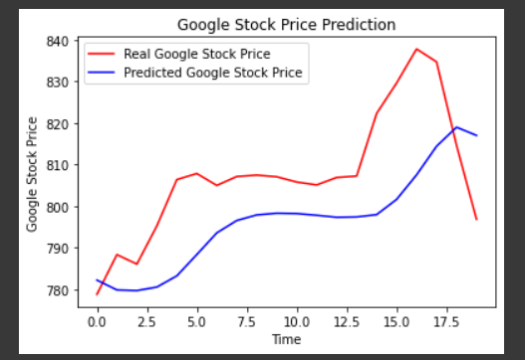
RESULTS
‹#›

Slide 12
CONCLUSION
The LSTM-based stock price prediction model embodies the convergence of technology and finance, presenting a progressive solution to the complexities of investment decision-making.
Backed by its demonstrated accuracy, adaptability, and ethical foundation, this model heralds a transformative shift in how investors engage with stock market analysis.
Its potential to deliver timely insights and informed predictions has the capacity to reshape investment strategies and enhance risk management practices.
This model impact is anticipated to extend far beyond traditional approaches, fostering a new era of data-driven decision-making in the financial landscape.
‹#›

